Slide 1
Capstone - Serena Xiaona Hang

Slide 2
Agenda
Overview
Problem Statement
Benefits
Approach for the solution
Key Findings and Insights
Key Questions to be answered
What are variables influence C02 emissions?
Which factor affects the C02 emission the most? What could be plausible reasons for that?
Recommendations to key decision-maker on balancing the reduction of carbon emission and affordable electricity production
Recommendations and Next Steps

Slide 3
Background/Problem Statement and Objective
Background/Problem:
Global warming is one of the foremost problems that humanity needs to solve to ensure our survival for the future. The accumulation of greenhouse gases is one of the primary contributors and CO2 is one of the biggest contributors to this greenhouse effect. Burning of the various sources of energy that can generate the electricity is the primary source of CO2 emissions. Balancing the reduction of carbon emission and affordable electricity production is crucial for controlling the catastrophic effects of global warming. Forecasting CO2 emissions can make an impact on this crucial decision-making.
Objective
In the real world, using data science to find patterns connected to large amounts of data that are connected to business insights can make an impact on data driven decision-making.
The intended goal is to use the carbon emissions dataset to build a time series model using the the AR, MA, ARMA, ARIMA and SARIMA models that can best forecast the CO2 emissions value for natural gas (NNEIEUS) fuel type for the next 12 months, and that can be adopted as policies to reduce these emissions.

Slide 4
Approach to the Solution
Summary: Profile the data to understand the different sources that contribute to CO2 emissions and identify primary factors of influence over time. Analyze the primary factors, then find the best model. Then deploy the best model to predict the next 12 months CO2 emissions.
Details on Approach:
1. Data preparation and dataset visualization.
2. Splitting the dataset to train data and test data.
3. After data preparation, the first task is to make the time-series stationary.
Verify if the series is stationary or not, follow the below methods:
Calculating the rolling mean and standard deviation
Augmented Dickey-Fuller (ADF) Test
The following methods to convert a non-stationary series into a stationary one
Log Transformation
By differencing the series (lagged series)
4. Decompose the time series components into Trends, Seasonality and Residuals.
5. Plot the ACP and PAC function to get p and q values for AR, MA, ARMA, ARIMA and SARIMA models.
7. Select the best model with the least RMSE or lowest AIC.
8. Use the inverse transformation to get back the original values.
9. Forecast the values for the next 12 months and comparing it with the test data.

Slide 5


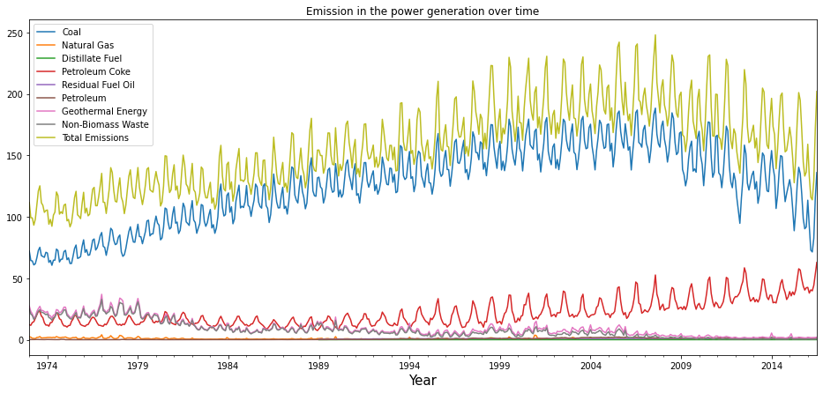
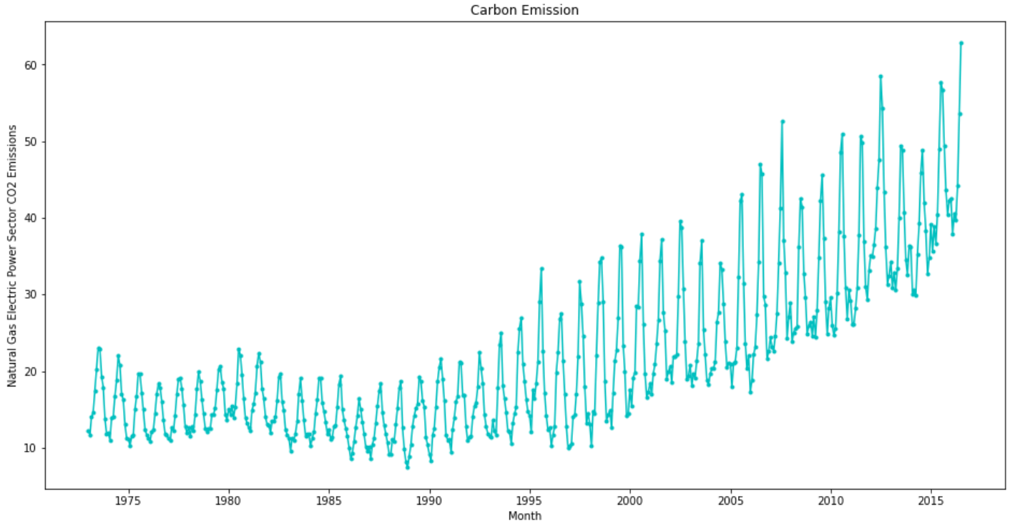
Key Findings and Insights Summary - 1
Summary:
In graph , Coal Electric Power (blue line) is the dominant source contributing to overall CO2 emissions (gold line) , and Petroleum Coke (red line) is the secondary source contributing to overall CO2 emissions (gold line).
In graph ,Natural Gas (green line) although not the dominant contributor of CO2 emissions as compared to Coal or Petroleum Coke, has approximately tripled in Carbon Emissions since 1975, and is widely used as an energy fuel.
1
2

Slide 6
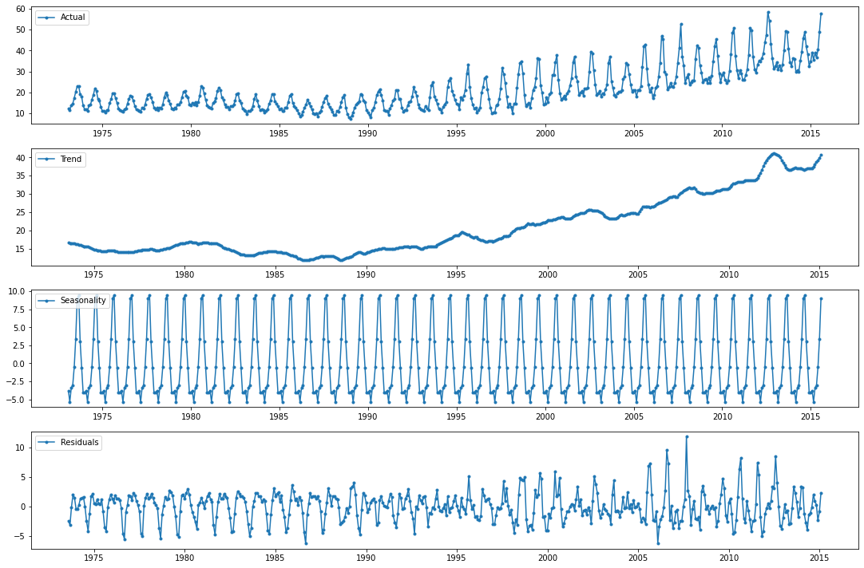
Key Findings and Insights Summary - Continued
Summary: Yearly Seasonality is big factor that influences Nature Gas CO2 emissions. 1st and 2nd Seasonality Cohort's drive emissions
The plot for seasonality shows that the Emissions Value spikes in July and August (1st Tier Cohort) and then has a second-tier cohort of emissions in June and September, and a third-tier cohort of emissions for May and October, and a fourth-tier cohort of emissions for the other months in the year.
One would guess that July/August 1st Tier Cohort spike is driven by very hot weather and air conditioning needs for both consumers and enterprise companies.
2nd tier cohort emissions are about 1/3 the volume of the 1st tier cohort emissions, and 3rd tier cohort emissions again are about 1/3 the volume of the 2nd tier cohort emissions.
3rd and 4th tier cohorts are zero or less CO2 emissions and represent 8 months of the year or 75% of the year.
Tier 1 Cohort
Tier 2 Cohort
Tier 3 Cohort
Tier 4 Cohort (6 months)

Slide 7
Recommendation(benefit and/or costs) and Next Steps
Data Science Recommendation:
The SARIMA model is performing better than other models thus we suggest adopting the SARIMA model to forecast the CO2 emissions value for natural gas (NNEIEUS) fuel type for the next 12 months.
Executive Recommendation:
To balance the reduction of carbon emission and affordable electricity production we suggest using less CO2 emitting fuel sources such as wind, solar, etc. in Tier 1 and Tier 2 seasonality cohort months.
For Sure DO NOT use Coal and Petroleum Coke fuel source in the Tier 1 and Tier 2 cohort seasonality months to augment the energy needs that are needed to meet the extra energy demands.
The expected benefit is to use the energy source with less CO2 emitting in the peak of the year. The unknowns are the cost and availability of the different fuel sources as this is not in the current data set.
Next Steps, we need to add data analysis regarding fuel source costs, fuel source availability and profit margins into this fuel and seasonality model such that we can recommend not only the lowest CO2 emissions, but also the most profitable sources.

Slide 8
Question ?

